Slide 1
DSCI – 6011 – 03 DEEP LEARNING
By
Yegneshwar Rao Ginjupalli
Avinash Reddy Bhavanam
Ramya Krishna Gadiparthi

Slide 2

DIGITAL IMAGE FORGERY DETECTION
By
Yegneshwar Rao Ginjupalli
Avinash Reddy Bhavanam
Ramya Krishna Gadiparthi

Slide 3
Statement:
In the age of digital media, image forgeries have become increasingly prevalent and sophisticated. From fake news to manipulated photos, the ability to detect image forgeries is crucial for maintaining the integrity of digital information. In this presentation, we will explore the different types of image forgeries, techniques for detection, and the challenges and limitations of current approaches.

Slide 4
Statement of Value:
The tampering of a digital image is called digital image forgery, these forged images cannot be detected by the naked eye. Such images are the primary sources of spreading fake news and misleading information in the context of society with the aid of diverse social media platforms like Facebook, Twitter, etc

Slide 5
Technical Approach
Train the CNN using feedforward and SoftMax
One of the main tasks of our study is to create a pipeline that can recognize forged images.
And for this we took the reference from an IEEE journal paper
This article makes use of MobilenetV2 architecture for feature extraction.
But as a change we made use of VGG16 architecture in this project for feature extraction.
We also making way to use the architectures like ResNet and GoogLeNet and evaluate our model.
Use pre-trained models to obtain the features and flattening of the image.
Train and test the model

Slide 6
Transfer Learning
Transfer learning can be used in image forgery detection by re-purposing a pre-trained model for a related task, such as image classification.
The pre-trained model can be fine-tuned on a smaller dataset of forged and authentic images to improve its accuracy in detecting image manipulation.
This approach can save time and resources compared to training a model from scratch for image forgery detection.

Slide 7
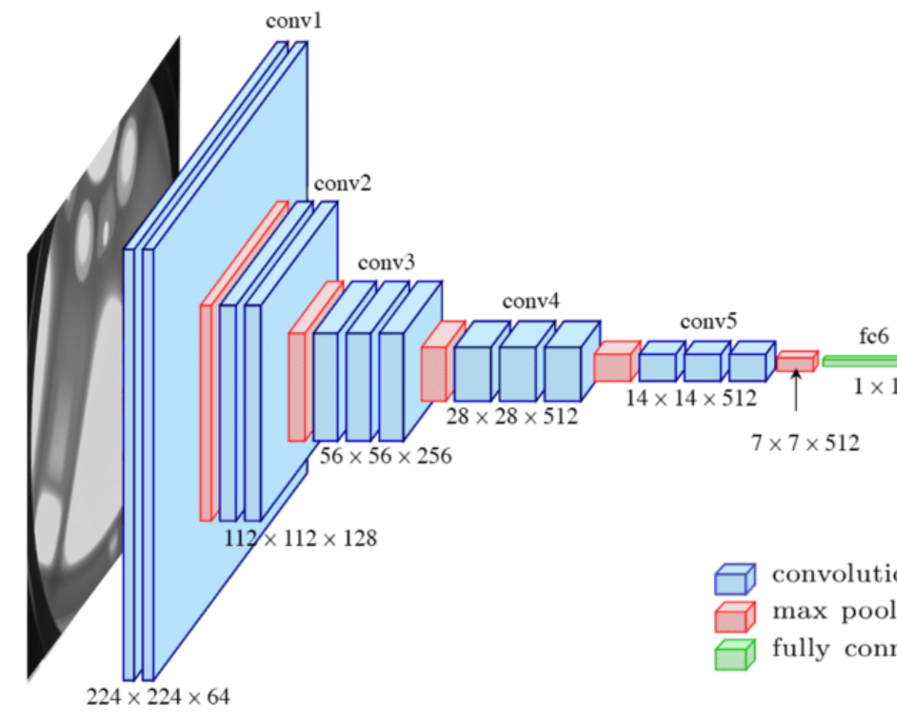
CNN Architecture for Image Forgery Detection
CNN architecture can be used to detect image forgery by analyzing the image's texture, color, and other features.
The CNN model is trained on a dataset of both authentic and manipulated images to learn the differences between the two types of images.
The model uses convolutional layers to identify patterns in the image, followed by pooling layers to reduce the dimensionality of the data.
The final output of the model is a prediction of whether the image is authentic or manipulated, based on the features identified by the convolutional layers.

Slide 8
VGG16 Architecture
VGG16, or Visual Geometry Group 16, is a widely-used Convolutional Neural Network (CNN) architecture for image classification tasks.
Depth: VGG16 has 16 layers, making it relatively deep.
Convolutional Layers: It consists of 13 convolutional layers, each followed by max-pooling layers.
Fully Connected Layers: Three fully connected layers are present at the end for classification.
Kernel Size: Standard 3x3 convolutional kernels are used throughout the network.
Padding: Same-padding is applied to maintain spatial dimensions.
Max Pooling: Employed after each set of convolutional layers for spatial down-sampling.
ReLU Activation: Rectified Linear Unit (ReLU) activation functions are used for non-linearity.

Slide 9
ResNet Vs GoogLeNet
GoogLeNet:
Key Feature: Utilizes Inception modules with parallel operations.
Depth: Designed with the idea of "width" (more filters) over depth.
Parallel Operations: Efficiently captures multi-level features through parallel operations within Inception modules.
Vanishing Gradient: Mitigates vanishing gradient through the use of 1x1 convolutions for dimensionality reduction.
Number of Parameters: Typically has fewer parameters compared to very deep networks like ResNet.
Applications: Well-suited for scenarios where computational efficiency is crucial, e.g., real-time applications, and mobile devices.
ResNet
Key Feature: Utilizes residual blocks with skip connections.
Depth: Deeper architectures, up to hundreds of layers.
Vanishing Gradient: Addresses vanishing gradient problem through skip connections, aiding in the training of deep networks.
Ease of Optimization: Residual learning simplifies optimization during training.
Number of Parameters: Can have a large number of parameters due to its depth.
Applications: Well-suited for tasks where depth and capturing intricate features are crucial, e.g., image classification, object detection.

Slide 10
Classification Task:
All the above-mentioned architectures consist of fully connected networks that classify the input image into 1000 classes. So each model architecture has to be modified to fit the binary classification problem with only two classes i.e. Authentic and forged.
Still the convolutional architectures should be undisturbed as they contain trainable parameters.
Thus, use of SVM classifier came to light. For the final part of the pipeline an SVM classifier is trained and tested

Slide 11
Model Training:
The input images are compressed before being fed into the convolutional networks.
To train the CNN architecture in a way that can focus on the tampered regions, image patches are extracted from the input and the tampered patches are discriminated from the non-tampered ones.
The tampered patches get compressed differently than the regular ones.
And this difference in the compression is identified in the SVM network and then classified.

Slide 12
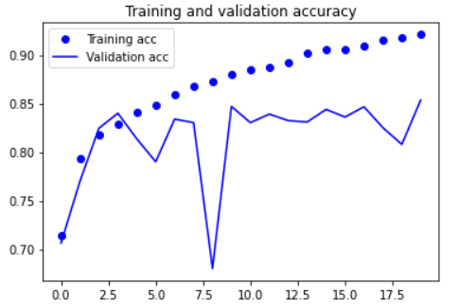
Evaluation:
The model performance is calculated using
the following matrices:
Accuracy: 73.83%
F1 Score: 0.74
Precision: 73.93%
Recall: 73.71%
The evaluation given is an approximated estimation after making corrections for better performance.

Slide 13

Thank You

